Slide 1

Data Mining Term project presentation
by Tori and Ericka

Slide 2
Objectives
Challenges
Perform data analysis on JD dataset
Survey current session-based recommendation systems and modify them to fit our problem
Implement session-based recommendation system in Federated Learning setting
Recommend category/item
Offer recommendations for not-logged users based only on their interactions
Limitations of dataset: considerable amount of products, no category metadata, no time-related attribute.

Slide 3
Session-based recommendation
Many people aren’t willing to register or login due to inconvenient procedure and worry about privacy leakage.
Session-based recommendation, a sub-area of sequential recommendation, has been an important task in online services like e-commerce and news portals [9]
Recommendation based on a sequence of events. e.g. next item prediction [2]

Slide 4
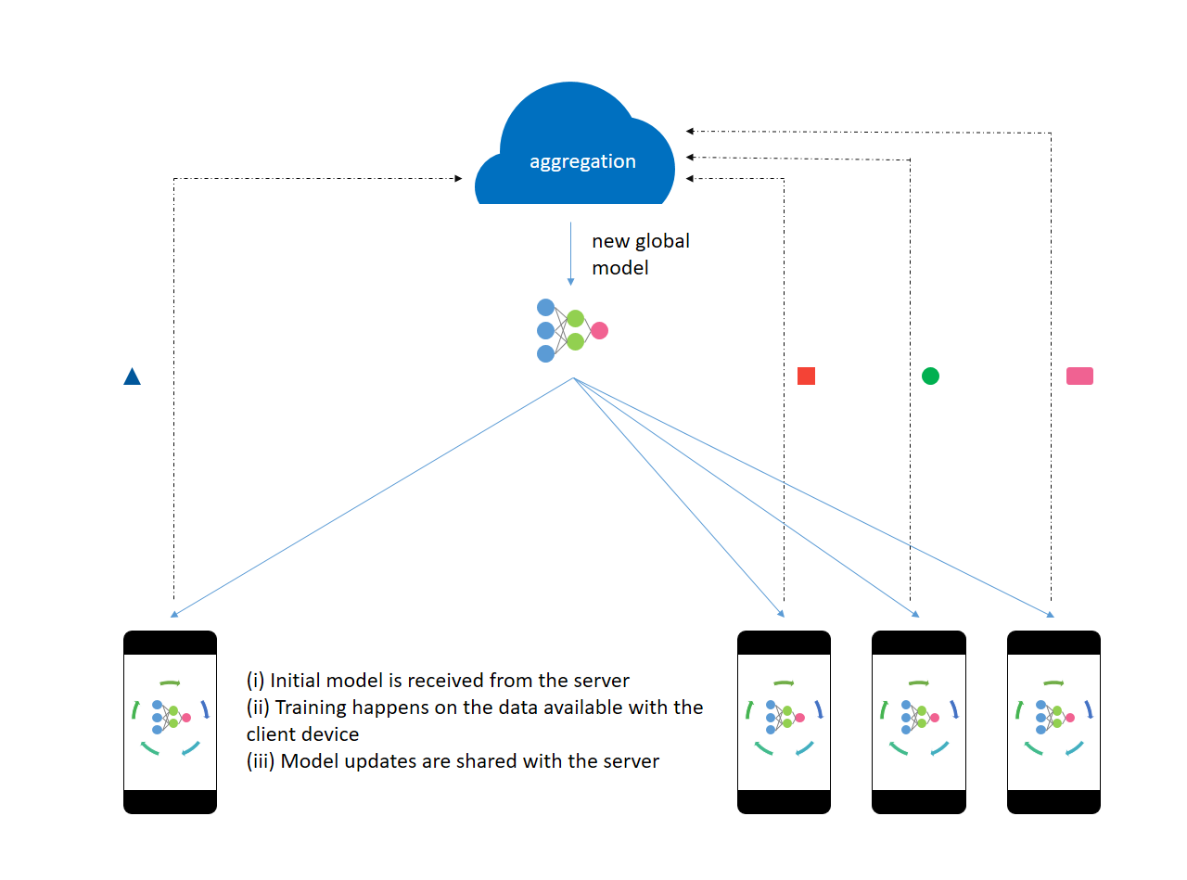
Federated Learning
The main idea of federated learning is to enable the execution of a single machine learning model in a distributed fashion over a number of edge devices [1]
https://zzaebok.github.io/federated_learning/machine_learning/Federated_Learning/

Slide 5
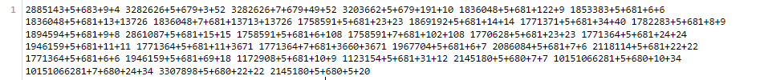
Dataset
From "Hierarchical User Profiling for E-commerce Recommender Systems" by Gu, Yulong and Ding, Zhuoye and Wang, Shuaiqiang and Yin, Dawei pubished in Proceedings of the 13th International Conference on Web Search and Data Mining, 2020.
sku + behavior_type + category + time_interval + dwell_time
~3,000,000 sessions in computers dataset.

Slide 6
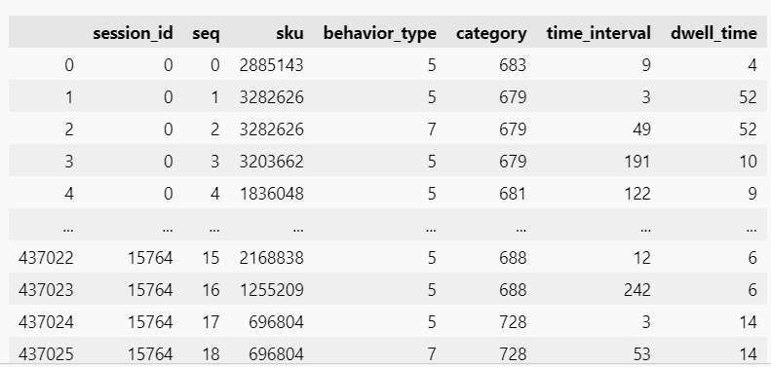
Data pre-processing

Slide 7
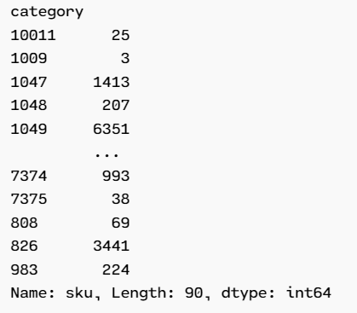
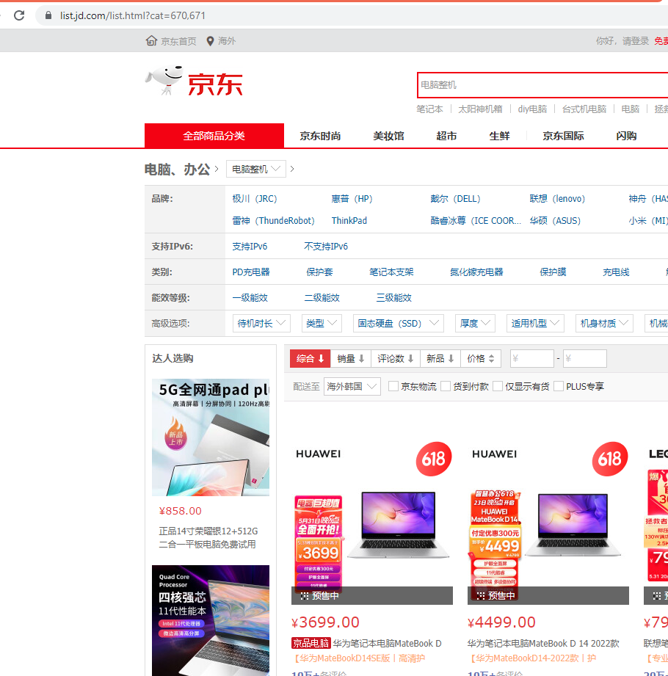
Data exploration
https://global.jd.com/

Slide 8
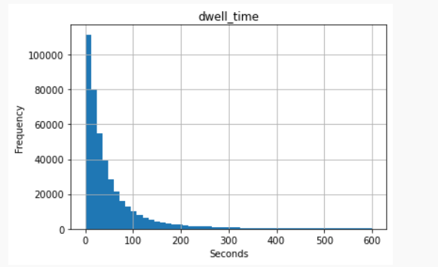
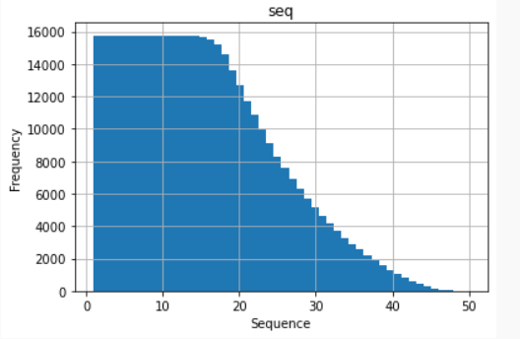
Data exploration

Slide 9
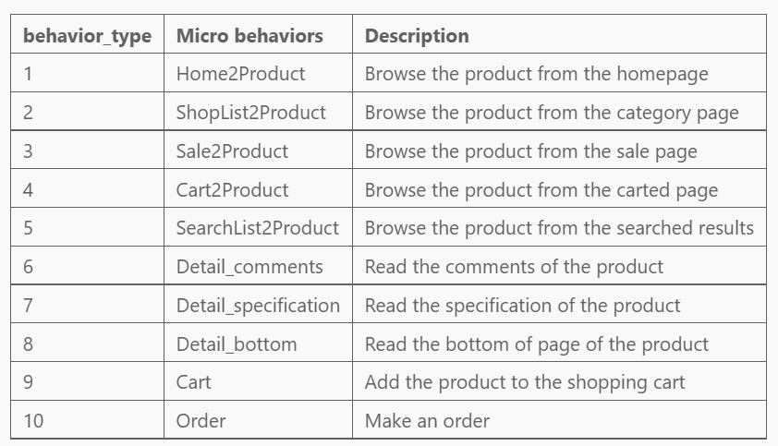
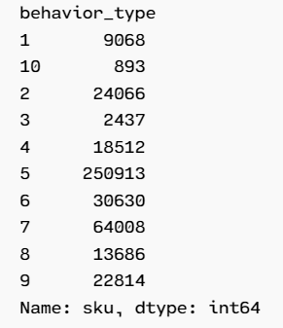
Data exploration

Slide 10
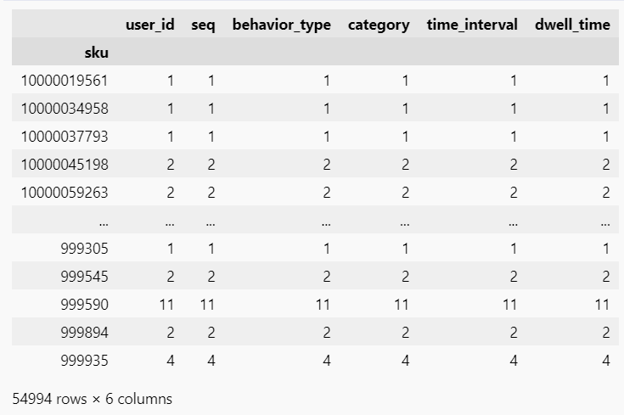
Data exploration

Slide 11

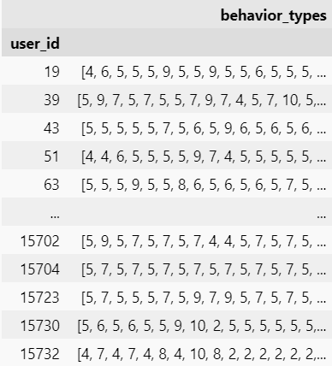
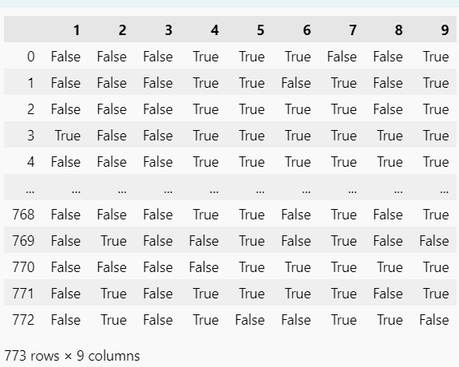
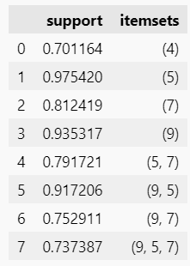
Association Rule
Filter by sessions where a product was bought

Slide 12
Association Rule
- Make it easy to your clients to access the search tool and offer insightful options
- Make sure all products have their specifications clear
- Clients buying after browsing the sales page does not have a lot of support. Why? Are they not good sales? Poorly designed? Not enough marketing? Research might make sales go up.
- Clients buying after reading comments does not have a lot of support. As above, research might help to make the comments more relevant to the buying process.

Slide 13

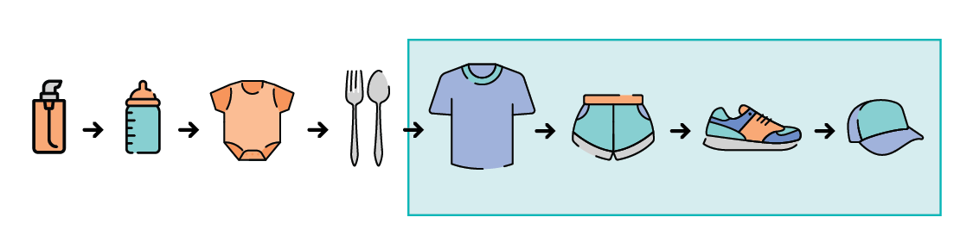
Session-Based Recommendation System
This method offer greater privacy for user [6].
Don’t need user identifier and user profile
Try to convert it into sequential stochastic decision problem
The task for our dataset: category recommendation and item recommendation
Category recommendation can help the recommender systems quickly figure out the main interest of the user and make better recommendations [4].

Slide 14
SR-SAN
Session-based recommendation with self attention networks [7].
Taking into consideration:
Current preference vs long term preference based on recent actions → a single item latent vector which jointly represents current interest and global interest
Learn item dependencies from long distance (dependencies among all items) → self attention layer

Slide 15
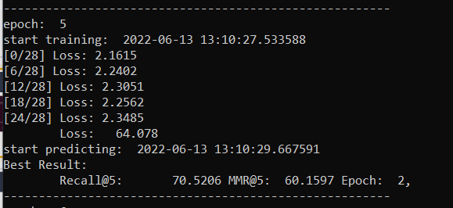
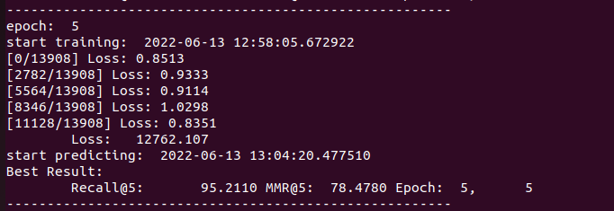
SR-SAN Category Recommendation
5 epoch 1,000 sessions (90s)
5 epoch 100,000 sessions (57 minutes)
Better recall than other methods but worst time. The time it takes to train worsens with longer sessions.

Slide 16
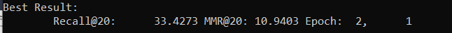
SR-SAN Item Recommendation
Needs a lot of resources!
Epoch 2, 1000 sessions

Slide 17
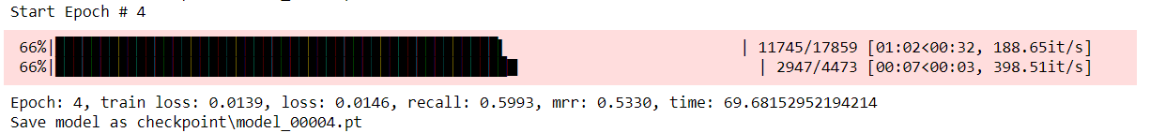
GRU4REC
Recurrent Neural Networks have been devised to model variable-length sequence data.
A Gated Recurrent Unit (GRU) [5] is a more elaborate model of an RNN unit that aims at dealing with the vanishing gradient problem.
It works well on short session-based data and matrix factorization approaches are not accurate.
It is one of the state-of-the-art for session-based recommendation system
Split data into training and testing (80% and 20%) based on session id.

Slide 18
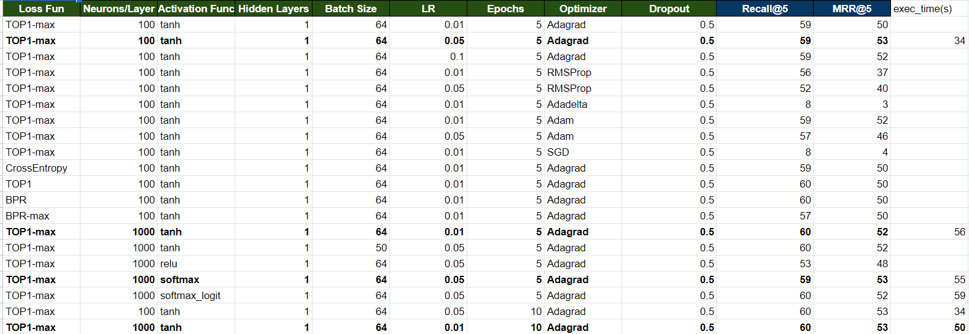
Experiments: Categorical Recommendation

Slide 19
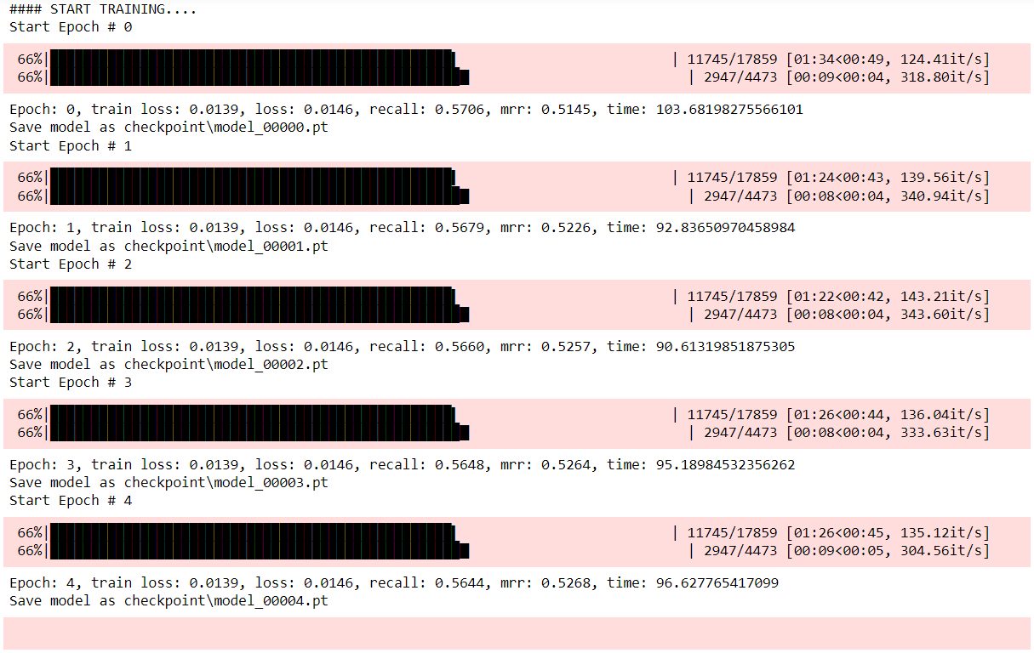
GRU4REC BI-DIRECTIONAL

Slide 20
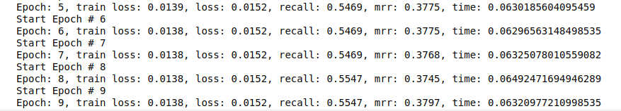
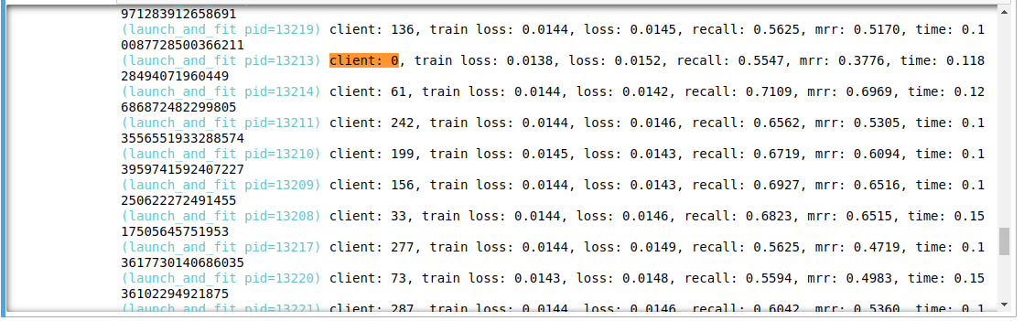
FL Settings for GRU4Rec
FL Settings divided session into 300 clients
Client 0
FL with FedAvg

Slide 21
Remarks & Future Work
Remarks
Data Mining helps us to solve business problems through data analysis. It was both interesting and challenging try to use Data Mining concepts to explore Recommendation Systems and use them for our solution.
To the best of our knowledge, Session-Based Recommendation Systems within Federated Learning setting is still not addressed, and this is a topic we would like to keep exploring to get better results based on our current data analysis.
Future Work
Implement SR-SAN in Federated Learning setting
Use category recommendation to implement item recommendation within the same dataset [4]

Slide 22

Questions or comments?

Slide 23
References
[1] Wahab, Omar Abdel, Gaith Rjoub, Jamal Bentahar, and Robin Cohen. “Federated against the Cold: A Trust-Based Federated Learning Approach to Counter the Cold Start Problem in Recommendation Systems.” Information Sciences 601 (July 2022): 189–206. https://doi.org/10.1016/j.ins.2022.04.027.
[2] Paperswithcode.com. “Papers with Code - Session-Based Recommendations,” 2022. https://paperswithcode.com/task/session-based-recommendations.
[3] Zhao, S., Bharati, R., Borcea, C., & Chen, Y. (2020). Privacy-aware federated learning for page recommendation. 2020 IEEE International Conference on Big Data (Big Data), 1071–1080.
[4] Gu, Y., Ding, Z., Wang, S., & Yin, D. (2020). Hierarchical user profiling for E-commerce recommender systems. Proceedings of the 13th International Conference on Web Search and Data Mining.
[5] Cho, Kyunghyun, van Merrienboer, Bart, Bahdanau, Dzmitry, and Bengio, Yoshua. On the proper- ¨ ties of neural machine translation: Encoder-decoder approaches. arXiv preprint arXiv:1409.1259, 2014
[6] Balázs Hidasi, Alexandros Karatzoglou, Linas Baltrunas, and Domonkos Tikk. 2015. Session-based Recommendations with Recurrent Neural Networks. arXiv (2015). arXiv:1511.06939
[7] Fang, Jun. “Session-Based Recommendation with Self- Attention Networks.” Accessed June 13, 2022. https://arxiv.org/ftp/arxiv/papers/2102/2102.01922.pdf.
‌

